Slide 1
”Ask Anything” Natural language Search
For Primo VE NDE
Yoel Kortick | May 2026

Slide 2
  Introduction
  Enabling the Ask Anything Natural Language Search
  What happens when Natural Language Search is enabled
  Ask Anything Natural Language Search - Example 1
  Ask Anything Natural Language Search - Example 2
  The conversion of natural language search to Boolean search – Example 1
  The conversion of natural language search to Boolean search – Example 2
  Viewing and using previous Ask Anything searches
  The difference between “Ask Anything” and “Primo Research Assistant”
  Reporting on the Ask Anything Natural Language Search in Mixpanel
  An example in the user's native language (not English) (example 1 of 5)
  An example in the user's native language (not English) (example 2 of 5)
  An example in the user's native language (not English) (example 3 of 5)
  An example in the user's native language (not English) (example 4 of 5)
  An example in the user's native language (not English) (example 5 of 5)
Agenda

Slide 3

Introduction

Slide 4
Introduction
In addition to this presentation, it is recommended to also see
  Getting Started with Primo Research Assistant
  Natural Language Search in the NDE UI
  The November 2025 Primo VE Release Notes
  The General Tab section of Overview of the NDE Interface and Configuration

Slide 5
Introduction
The “Natural Language Search” feature in Primo VE NDE enables users to formulate queries in “normal spoken language”.
The query in “normal spoken language” is automatically converted to a query which can be handled by the Primo search engine
For example, the user can enter the query, "Find me library science journals in English that are available online,“ or “What books are there by or about Gloria Steinem or Sheryl Sandberg”.
In these cases, the system will create a query with the appropriate criteria for the search.

Slide 6
Introduction
The transformation of the original query into the structured format is performed using generative AI.
The generative AI classifies the elements of the original query does as follows:
It generates a basic Boolean query
Expands the basic Boolean query using related concepts.
When creating the Boolean query ambiguous inputs are handled intelligently by mapping to multiple fields (e.g., both Title and Subject) to ensure broad yet accurate retrieval.

Slide 7
Enabling the Ask Anything Natural Language Search

Slide 8
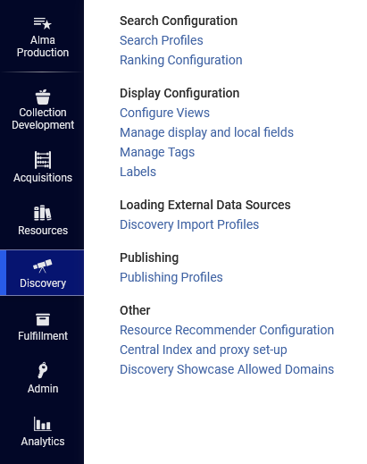
Enabling the Ask Anything Natural Language Search
Natural Language Search is enabled by default.
It can be enabled or disabled per View in the View Configuration page
To access the configuration, edit the view at “Discovery > Display Configuration > Configure Views”:

Slide 9
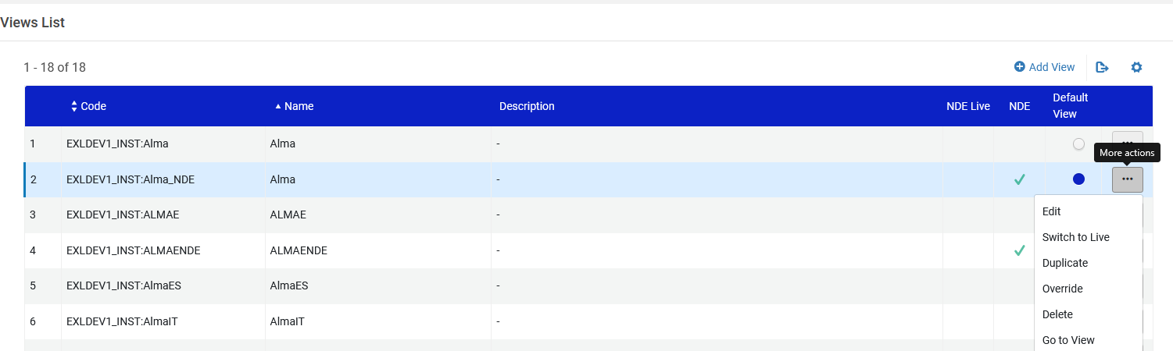
Enabling the Ask Anything Natural Language Search
Edit the desired view

Slide 10
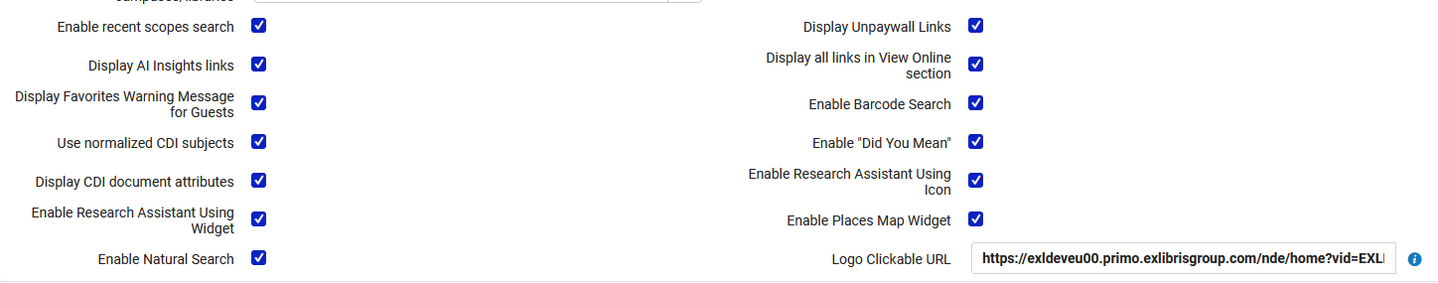
Enabling the Ask Anything Natural Language Search
The “Enable Natural Search” checkbox enables the “Ask Anything Natural Language Search” and appears in the “General” tab when configuring the view

Slide 11
What happens when Natural Language Search is enabled

Slide 12
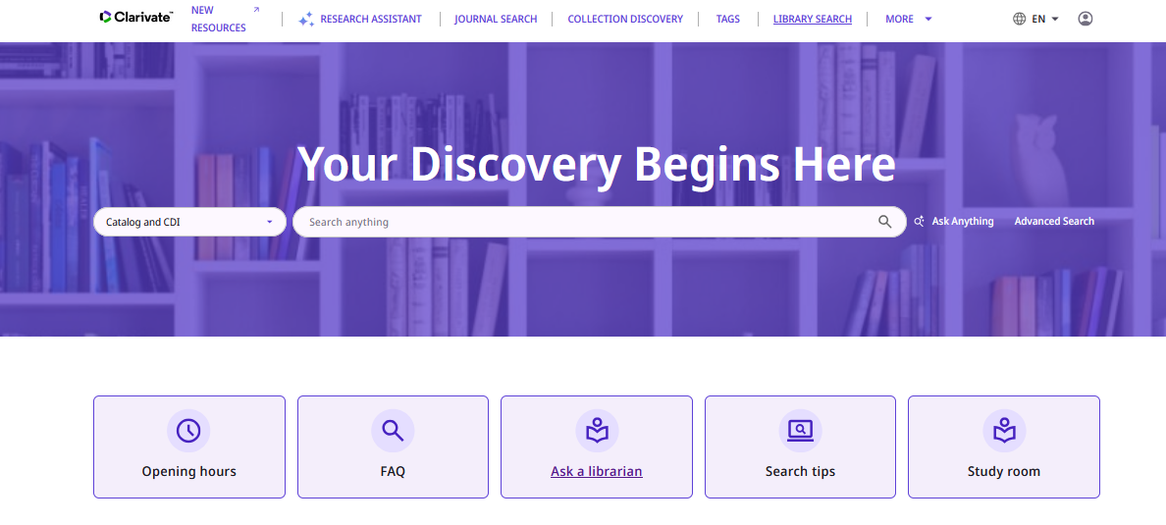
What happens when Natural Language Search is enabled
When Natural Language Search is enabled, an “Ask Anything” button appears beside the Search box.

Slide 13
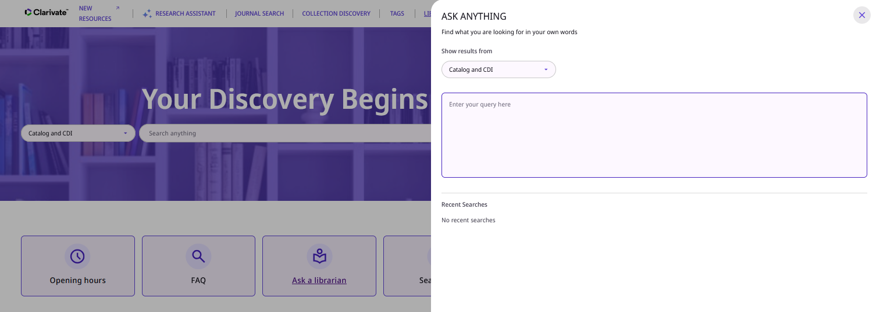
What happens when Natural Language Search is enabled
When the user selects the button, the “Ask Anything” page opens.

Slide 14
Ask Anything Natural Language Search - Example 1

Slide 15
Ask Anything Natural Language Search - Example 1
The Primo end user will click ”Ask Anything”

Slide 16
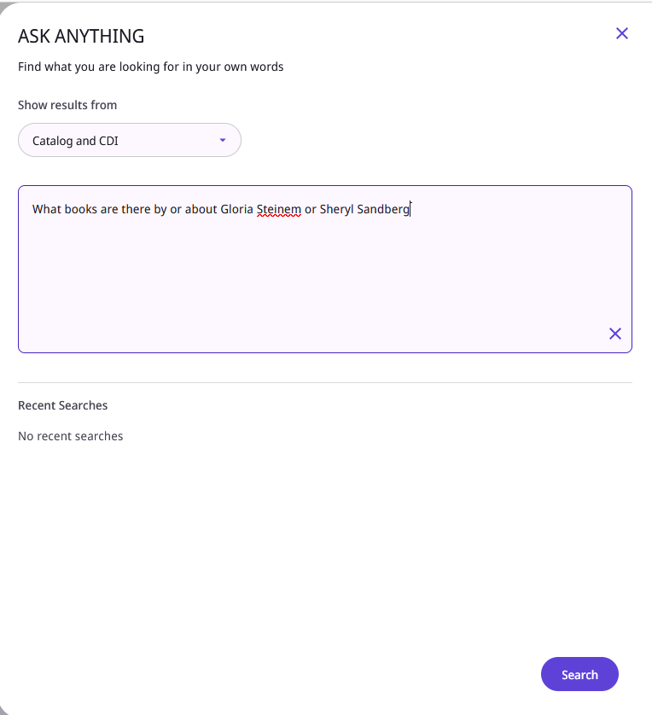
Ask Anything Natural Language Search - Example 1
The user selects a scope, enters a query, and initiates the search.
1. Selects a scope
Here the user searches for “What books are there by or about Gloria Steinem or Sheryl Sandberg”
2. Enters a query
3. Initiates the search

Slide 17
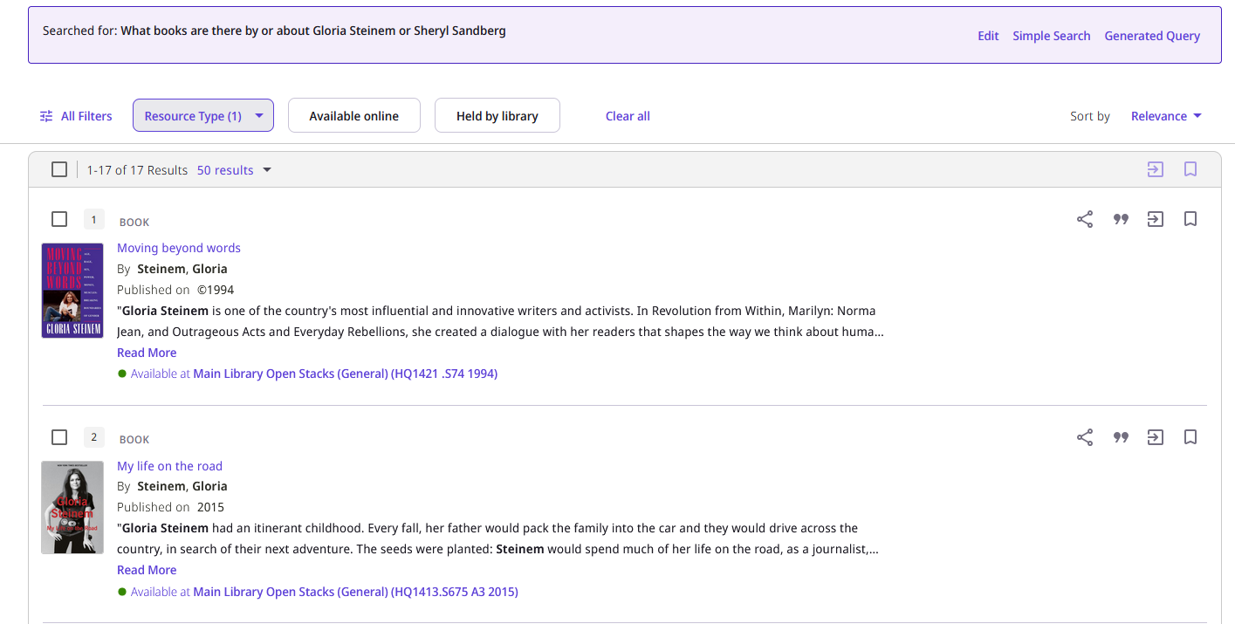
Ask Anything Natural Language Search - Example 1
The query is converted into the form recognized by the search engine, and the brief results open.
A bar above the results shows the search query and provides editing options.
Results are all books

Slide 18
Ask Anything Natural Language Search - Example 1
If the user wishes, he or she can change the natural language search text by clicking “Edit”
We will click “Edit”
Instead of
“What books are there by or about Gloria Steinem or Sheryl Sandberg “
we will search for
“What books and scholarly journal articles are there by or about Gloria Steinem or Sheryl Sandberg “

Slide 19
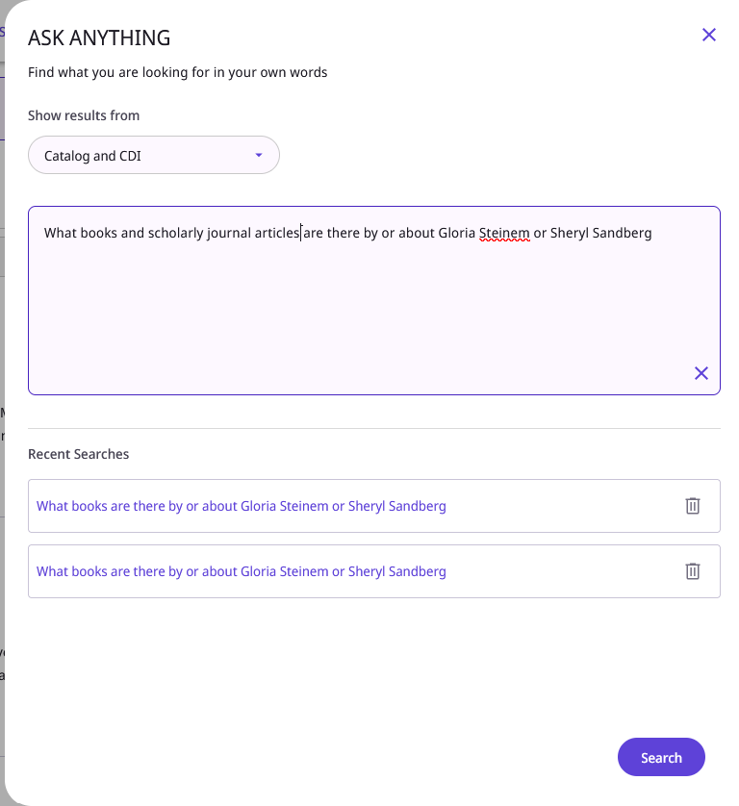
Ask Anything Natural Language Search - Example 1
If the user wishes, he or she can change the natural language search text by clicking “Edit”
We are leaving the scope as “Catalog and CDI”
We change the search query from:
“What books are there by or about Gloria Steinem or Sheryl Sandberg “
to:
“What books and scholarly journal articles are there by or about Gloria Steinem or Sheryl Sandberg “

Slide 20
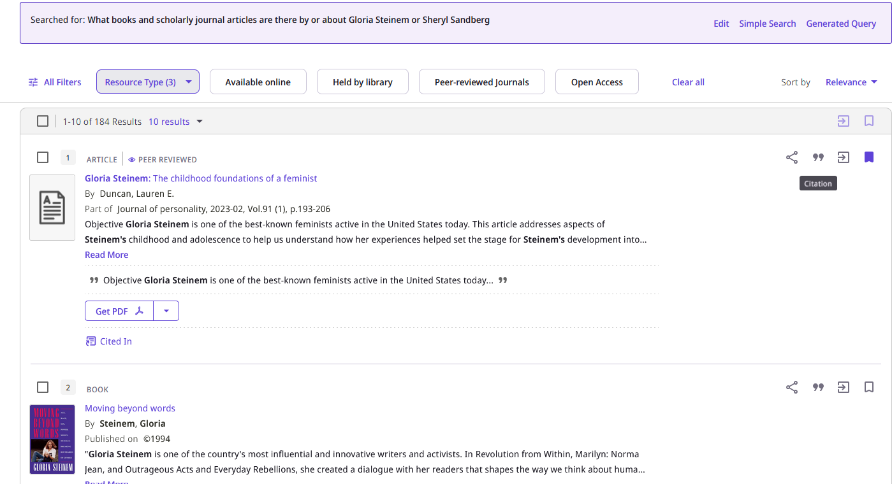
Ask Anything Natural Language Search - Example 1
The new edited search is performed
Results are books and articles

Slide 21
Ask Anything Natural Language Search - Example 2

Slide 22
Ask Anything Natural Language Search - Example 2
The Primo end user will click ”Ask Anything”

Slide 23
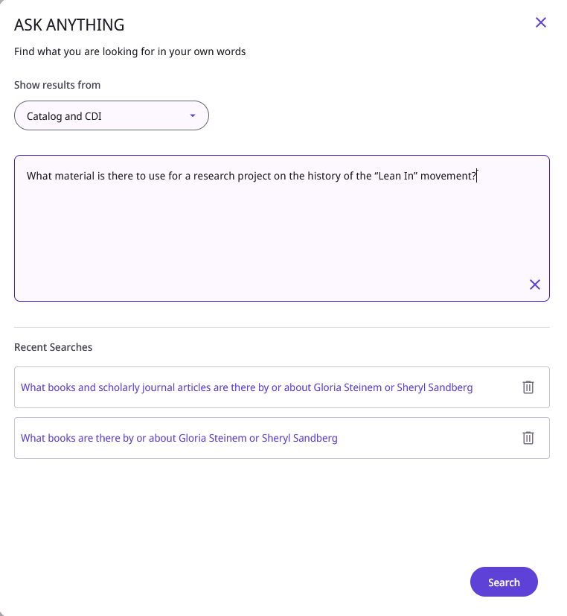
Ask Anything Natural Language Search - Example 2
The user selects a scope, enters a query, and initiates the search.
1. Selects a scope
Here the user searches for “What material is there to use for a research project on the history of the “Lean In” movement?”
2. Enters a query
3. Initiates the search

Slide 24
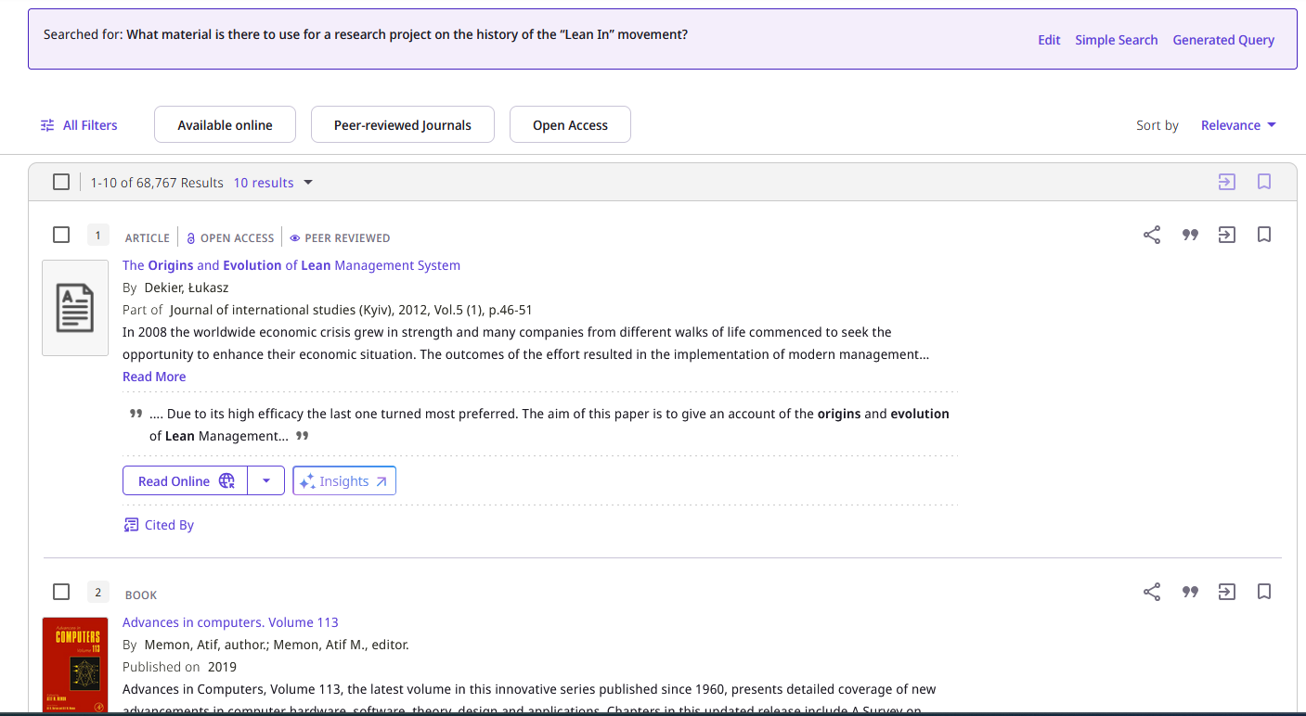
Ask Anything Natural Language Search - Example 2
The query is converted into the form recognized by the search engine, and the brief results open.
A bar above the results shows the search query and provides editing options.

Slide 25
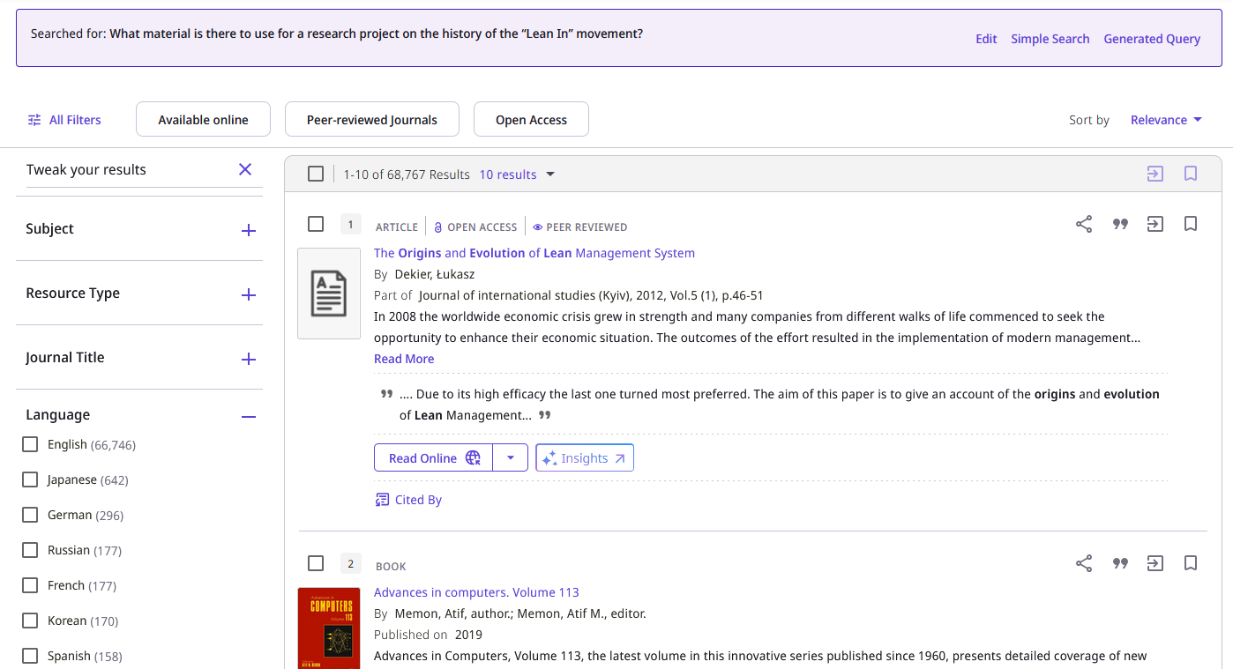
Ask Anything Natural Language Search - Example 2
If we look at the filters, we see that a lot of the 68,767 results are in a language other than English

Slide 26

Ask Anything Natural Language Search - Example 2
If the user wishes, he or she can change the natural language search text by clicking “Edit”
We will click “Edit”
Instead of “What material is there to use for a research project on the history of the “Lean In” movement?“
we will search for
“What material is there in English to use for a research project on the history of the “Lean In” movement? “

Slide 27
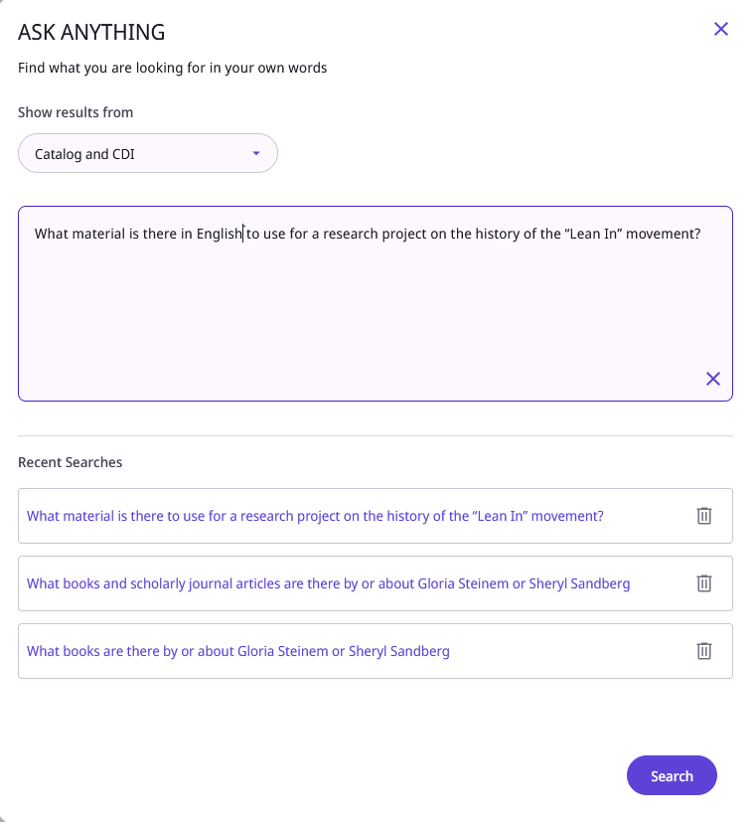
Ask Anything Natural Language Search - Example 2
If the user wishes, he or she can change the natural language search text by clicking “Edit”
We are leaving the scope as “Catalog and CDI”
We change the search query from:
“What material is there to use for a research project on the history of the “Lean In” movement?“
to:
“What material is there in English to use for a research project on the history of the “Lean In” movement?“

Slide 28
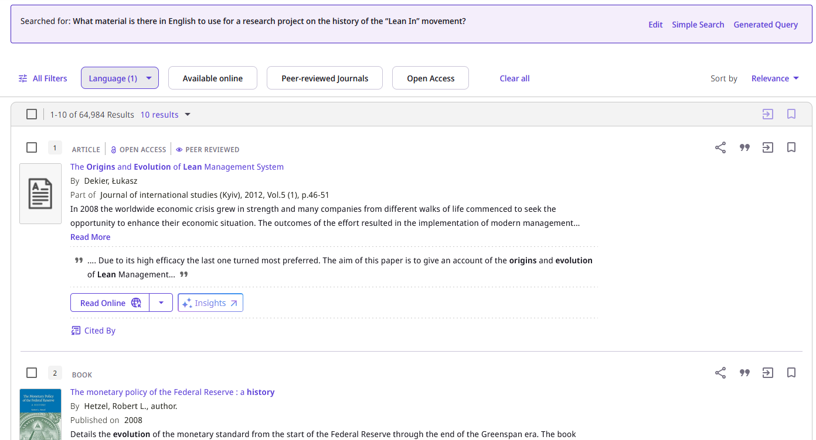
Ask Anything Natural Language Search - Example 2
The new edited search is performed
Instead of 68,767 results we have 64,984 results, and one language.

Slide 29
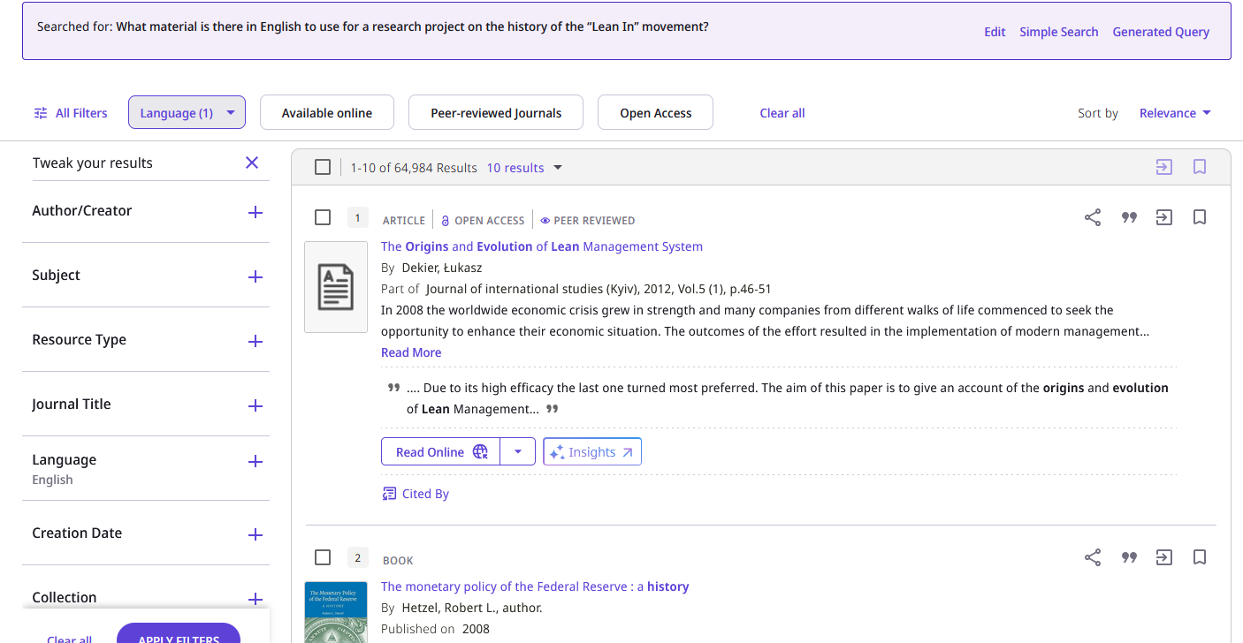
Ask Anything Natural Language Search - Example 2
If we view the filters, we see that it is automatically faceted by English (because our Natural language Search specified “in English”).

Slide 30
The conversion of natural language search to Boolean search – example 1

Slide 31
The conversion of natural language search to Boolean search – example 1
Users can view (and if desired modify) the generated Boolean search by selecting Generated Query.
This is the search for “What books are there by or about Gloria Steinem or Sheryl Sandberg”
We will click “Generated Query”

Slide 32
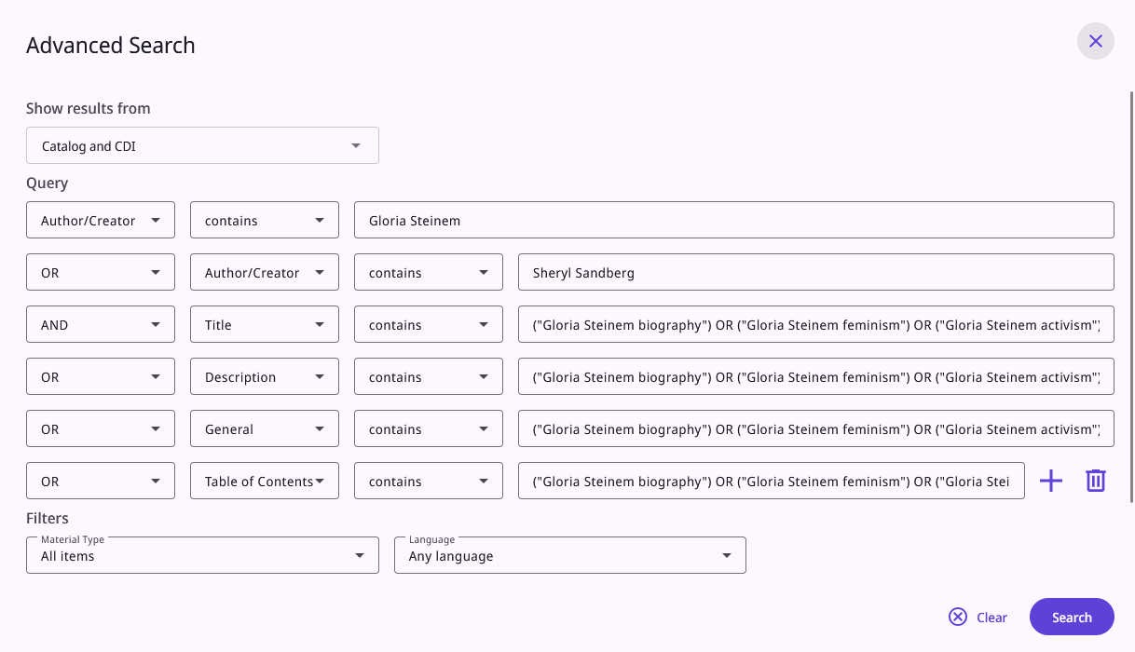
The conversion of natural language search to Boolean search – example 1
We can see (and if desired change) the query generated by Primo from the natural language search

Slide 33
The conversion of natural language search to Boolean search – example 1
Here is the conversion from natural language search to Boolean search
Natural Language Search | Boolean Search
What books are there by or about Gloria Steinem or Sheryl Sandberg | Author/Creator contains Gloria Steinem OR Author/Creator contains Sheryl Sandberg AND Title contains ("Gloria Steinem biography") OR ("Gloria Steinem feminism") OR ("Gloria Steinem activism") OR ("Sheryl Sandberg leadership") OR ("Sheryl Sandberg women in business") OR ("Sheryl Sandberg Lean In") OR Description contains ("Gloria Steinem biography") OR ("Gloria Steinem feminism") OR ("Gloria Steinem activism") OR ("Sheryl Sandberg leadership") OR ("Sheryl Sandberg women in business") OR ("Sheryl Sandberg Lean In") OR General contains ("Gloria Steinem biography") OR ("Gloria Steinem feminism") OR ("Gloria Steinem activism") OR ("Sheryl Sandberg leadership") OR ("Sheryl Sandberg women in business") OR ("Sheryl Sandberg Lean In") OR Table of Contents contains ("Gloria Steinem biography") OR ("Gloria Steinem feminism") OR ("Gloria Steinem activism") OR ("Sheryl Sandberg leadership") OR ("Sheryl Sandberg women in business") OR ("Sheryl Sandberg Lean In")

Slide 34
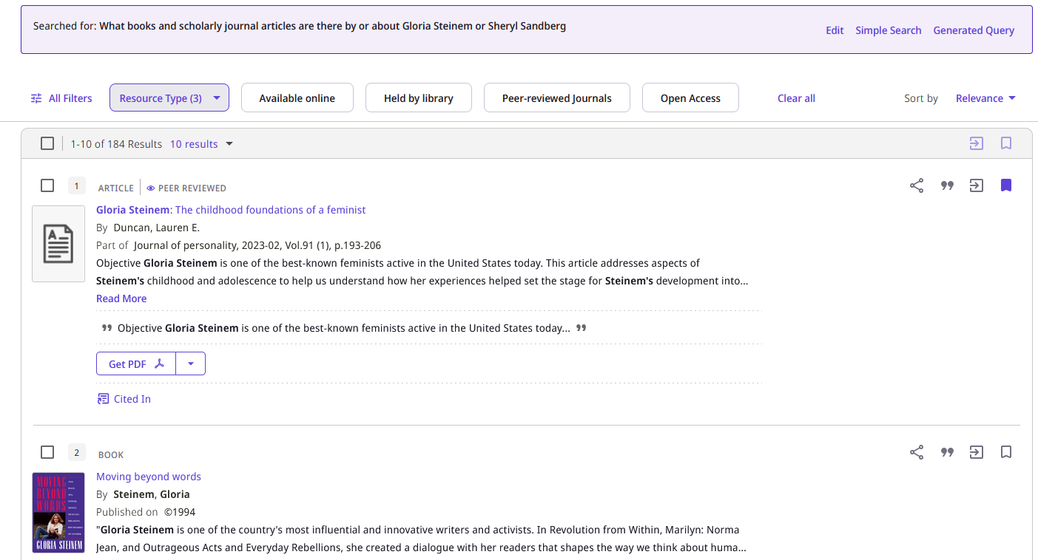
The conversion of natural language search to Boolean search – example 1
This is the search for “What books and scholarly journal articles are there by or about Gloria Steinem or Sheryl Sandberg”
We will click “Generated Query”

Slide 35
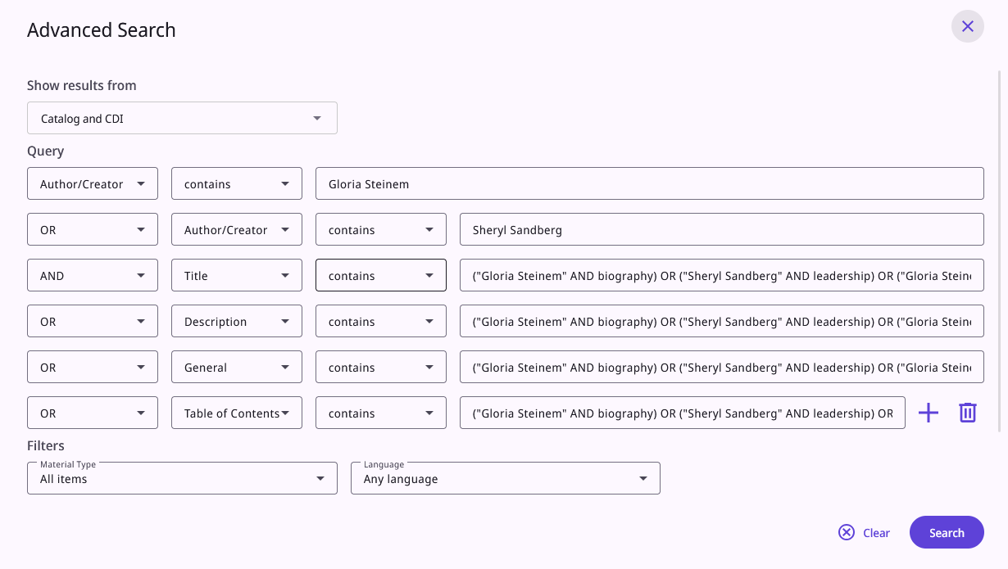
The conversion of natural language search to Boolean search – example 1
We can see (and if desired change) the query generated by Primo from the natural language search

Slide 36
The conversion of natural language search to Boolean search – example 1
Here is the conversion from natural language search to Boolean search
Natural Language Search | Boolean Search
What books and scholarly journal articles are there by or about Gloria Steinem or Sheryl Sandberg | Author/Creator contains Gloria Steinem OR Author/Creator contains Sheryl Sandberg AND Title contains ("Gloria Steinem" AND biography) OR ("Sheryl Sandberg" AND leadership) OR ("Gloria Steinem" AND feminism) OR ("Sheryl Sandberg" AND workplace equality) OR ("Gloria Steinem" AND activism) OR ("Sheryl Sandberg" AND women in business) OR Description contains ("Gloria Steinem" AND biography) OR ("Sheryl Sandberg" AND leadership) OR ("Gloria Steinem" AND feminism) OR ("Sheryl Sandberg" AND workplace equality) OR ("Gloria Steinem" AND activism) OR ("Sheryl Sandberg" AND women in business) OR General contains ("Gloria Steinem" AND biography) OR ("Sheryl Sandberg" AND leadership) OR ("Gloria Steinem" AND feminism) OR ("Sheryl Sandberg" AND workplace equality) OR ("Gloria Steinem" AND activism) OR ("Sheryl Sandberg" AND women in business) OR Table of Contents contains ("Gloria Steinem" AND biography) OR ("Sheryl Sandberg" AND leadership) OR ("Gloria Steinem" AND feminism) OR ("Sheryl Sandberg" AND workplace equality) OR ("Gloria Steinem" AND activism) OR ("Sheryl Sandberg" AND women in business)

Slide 37
The conversion of natural language search to Boolean search – example 2

Slide 38
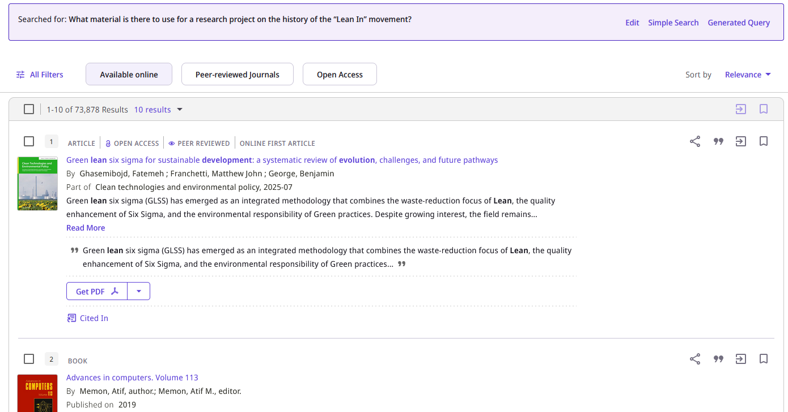
The conversion of natural language search to Boolean search – example 2
Users can (and if desired modify) the generated Boolean search by selecting Generated Query.
This is the search for “What material is there to use for a research project on the history of the “Lean In” movement?”
We will click “Generated Query”

Slide 39
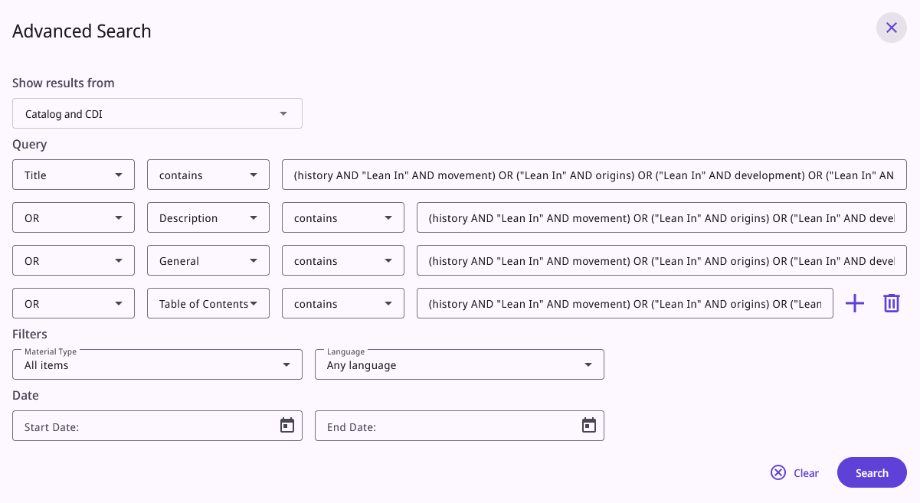
The conversion of natural language search to Boolean search – example 2
We can see (and if desired change) the query generated by Primo from the natural language search

Slide 40
The conversion of natural language search to Boolean search – example 2
Here is the conversion from natural language search to Boolean search
Natural Language Search | Boolean Search
What material is there to use for a research project on the history of the “Lean In” movement? | Title contains (history AND "Lean In" AND movement) OR ("Lean In" AND origins) OR ("Lean In" AND development) OR ("Lean In" AND background) OR ("Lean In" AND evolution) OR ("Lean In" AND impact)

Slide 41
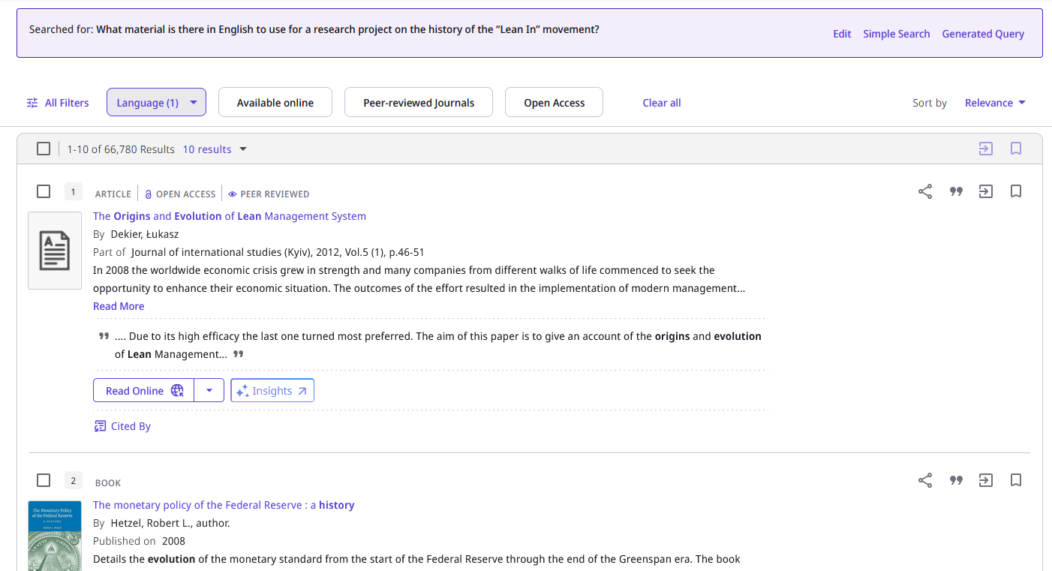
The conversion of natural language search to Boolean search – example 2
This is the search for “What material is there in English to use for a research project on the history of the “Lean In” movement?”
We will click “Generated Query”

Slide 42
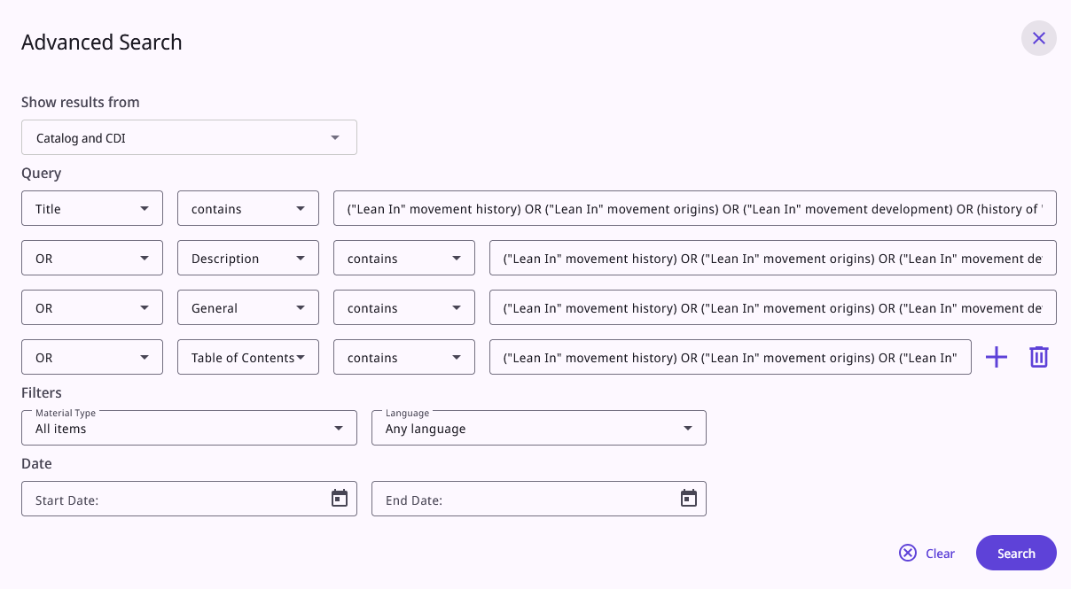
The conversion of natural language search to Boolean search – example 2
We can see (and if desired change) the query generated by Primo from the natural language search

Slide 43
The conversion of natural language search to Boolean search – example 2
Here is the conversion from natural language search to Boolean search
Natural Language Search | Boolean Search
What material is there in English to use for a research project on the history of the “Lean In” movement? | Searched for: Title contains ("Lean In" movement history) OR ("Lean In" movement origins) OR ("Lean In" movement development) OR (history of "Lean In" movement) OR ("Lean In" movement evolution) OR ("Lean In" movement background)

Slide 44
Viewing and using previous Ask Anything searches

Slide 45
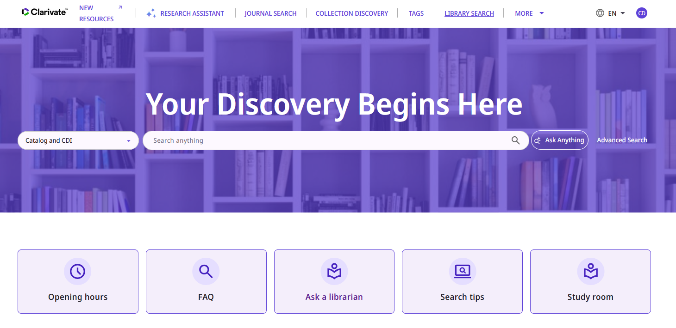
Viewing and using previous Ask Anything searches
The user will now click “Ask Anything”

Slide 46
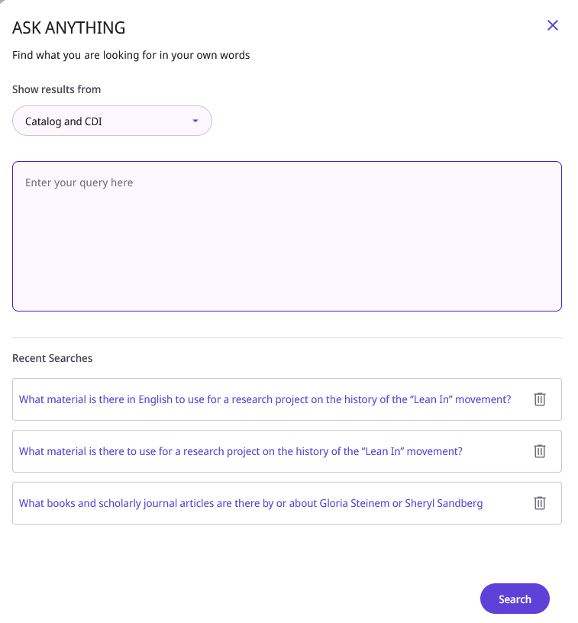
Viewing and using previous Ask Anything searches
When a user clicks “Ask Anything” his or her recent “Ask Anything” searches appear
Specific searches can be removed

Slide 47
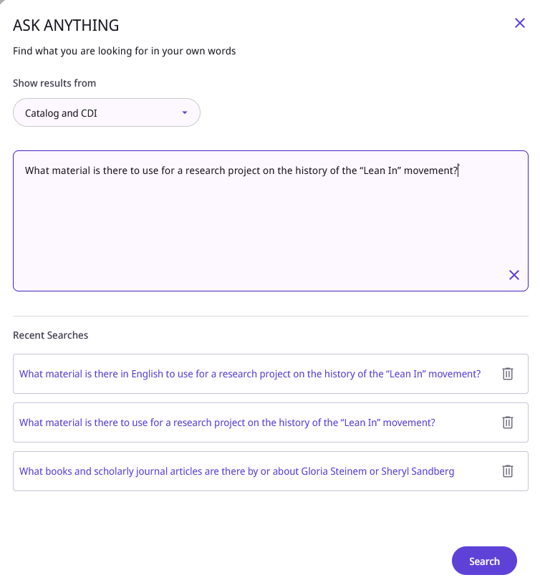
Viewing and using previous Ask Anything searches
Clicking on a recent search causes it to appear in the search box.
We clicked below on “What material is there to use for a research project on the history of the “Lean In” movement?” and now it appears in the search box.
We can now either
Edit the text of the search
Leave the text of the search as it is and click “Search” to perform another search

Slide 48
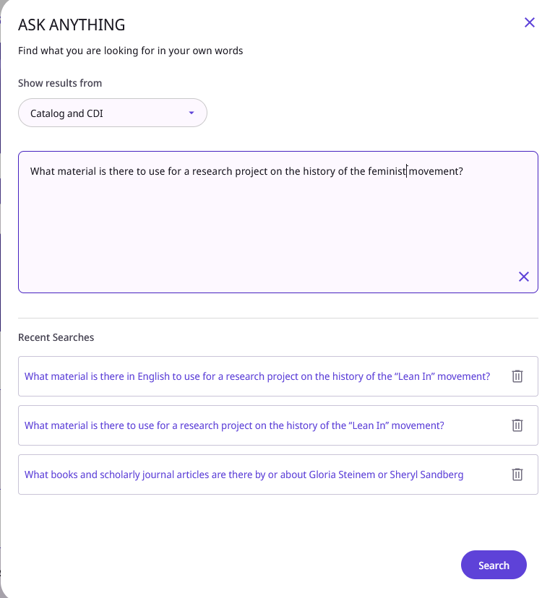
Viewing and using previous Ask Anything searches
We have changed the text from
What material is there to use for a research project on the history of the “Lean In” movement?
To
What material is there to use for a research project on the history of the feminist movement?
We will search

Slide 49
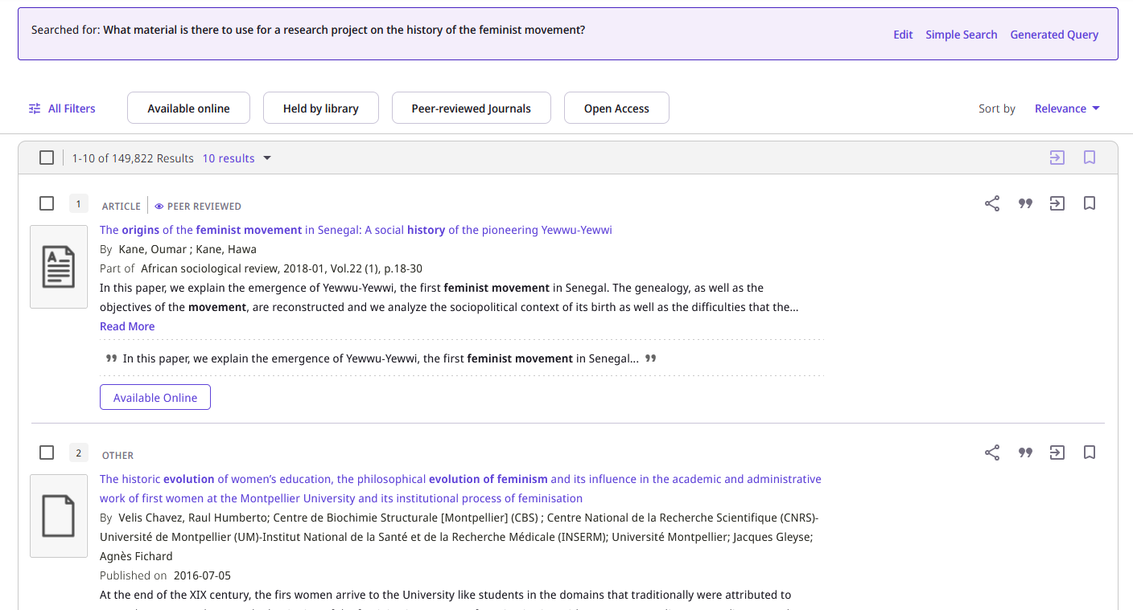
Viewing and using previous Ask Anything searches
The new search is performed. We will click “Edit”
And if now we click on “edit”…

Slide 50
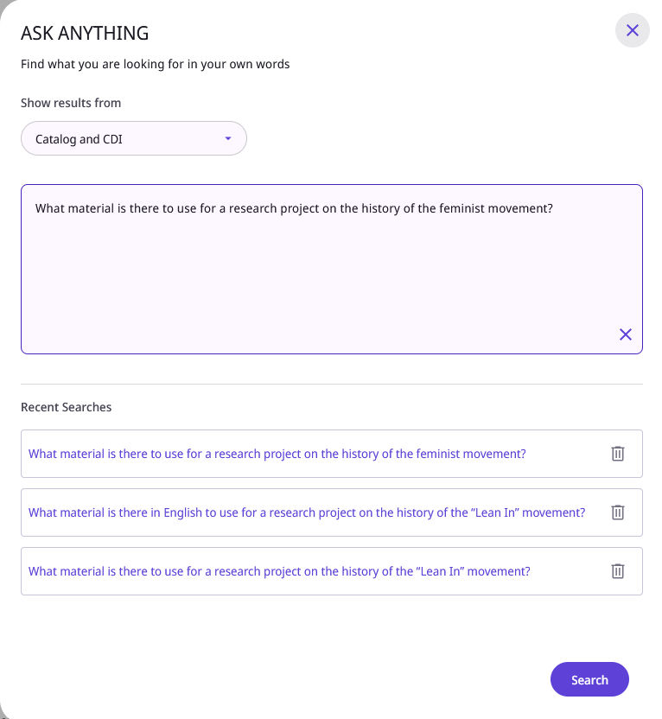
Viewing and using previous Ask Anything searches
The new search appears in the recent searches

Slide 51
Viewing and using previous Ask Anything searches
Note regarding the “Recent Searches”:
  The three most recent searches appear. If one of them is deleted and there is another recent search, then it will appear.
  Recent “Ask Anything” searches are saved per user.
    If a user is logged in and does the “Ask Anything”, and then logs out, and then logs in again, his or her recent searches will appear.
  If a user is not logged in, then the “Ask Anything” searches are saved per session.

Slide 52
The difference between “Ask Anything” and “Primo Research Assistant”

Slide 53
The difference between “Ask Anything” and “Primo Research Assistant”
The Primo Research Assistant provides
  Sources related to the query
  A link to the sources
  An overview of the sources
  Related research questions
The “Ask Anything” provides
  A search in Primo based on the natural language search

Slide 54
The difference between “Ask Anything” and “Primo Research Assistant”
The Primo Research Assistant query asks for information, not for resources
  Who were some of Gloria Steinem’s more known colleagues with whom she influenced the feminist movement in the United States?
The “Ask Anything” query is like a search, but in natural language
  What books and scholarly articles exist about Gloria Steinem and her colleagues in the feminist movement in the United States?

Slide 55
The difference between “Ask Anything” and “Primo Research Assistant”
Feature/ Capability | Description | Example
Research Assistant (RA) | Generates short, reliable answers based on repository and CDI content | “Who was Mary Wollstonecraft?”
Natural Language Search (NLS) | Interprets user intent and transforms natural queries into structured Boolean searches | “Books and scholarly articles about Mary Wollstonecraft”

Slide 56
Reporting on the Ask Anything Natural Language Search in Mixpanel

Slide 57
Reporting on the Ask Anything Natural Language Search in Mixpanel
It is possible to report on the Ask Anything Natural Language Search in Mixpanel by using the metric “Search” and filtering by “Search Type Is Natural Language”.
For a detailed and in-depth example see How to create a Mixpanel Insights Report of Ask Anything Natural Language Search queries for a specified time period

Slide 58
An example in the user's native language (not English) (example 1 of 5)

Slide 59
An example in the user's native language (not English) - 1
We will now use the Ask Anything Natural language Search in our native language (in this case French).
The “natural language search query” in English | The “natural language search query” in French
I need resources about library and information science in Poland, with a special emphasis on Krakow. The material should be online and published within the last ten years. | J’ai besoin de ressources sur les sciences de l’information et les bibliothèques en Pologne, et plus particulièrement sur Cracovie. Les documents doivent être en ligne et avoir été publiés au cours des dix dernières années.

Slide 60
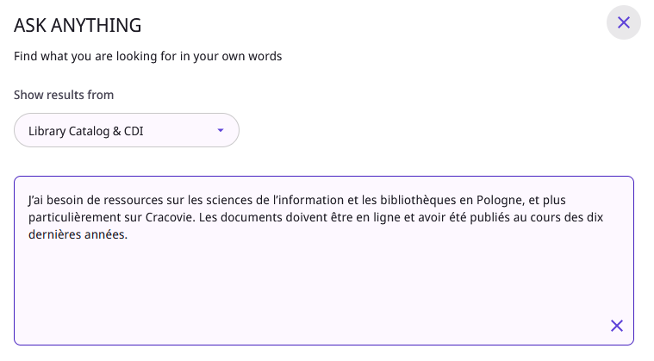
An example in the user's native language (not English) - 1
We use the Primo Ask Anything Natural language Search in our native language (in this case French).

Slide 61
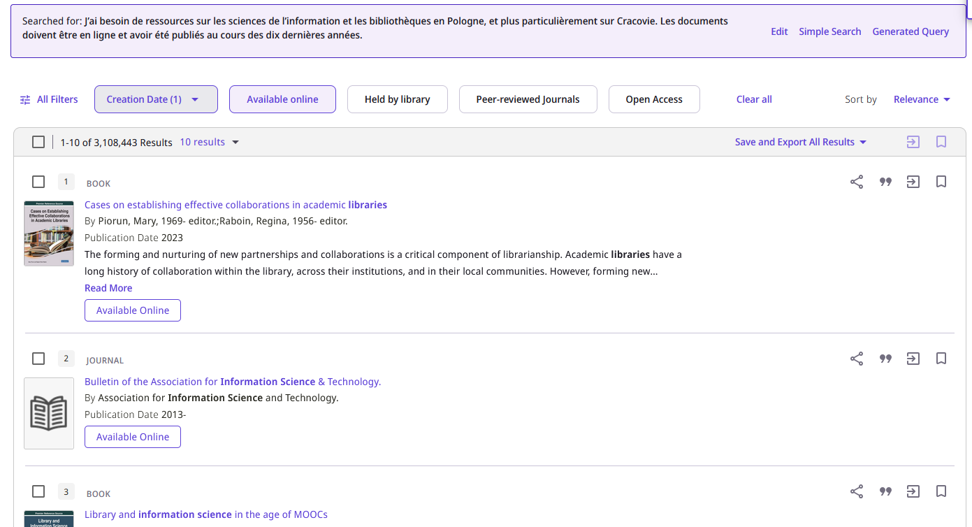
An example in the user's native language (not English) - 1
We get the results
Prefiltered by creation date and available online because this is what we asked for in the query

Slide 62
An example in the user's native language (not English) (example 2 of 5)

Slide 63
An example in the user's native language (not English) - 2
We will now use the Ask Anything Natural language Search in our native language (in this case Spanish).
The “natural language search query” in English | The “natural language search query” in Spanish
I need resources about library and information science in Poland, with a special emphasis on Krakow. The material should be online and published within the last ten years. | Necesito recursos sobre bibliotecología y ciencias de la información en Polonia, con especial énfasis en Cracovia. El material debe estar en línea y publicado dentro de los últimos diez años.

Slide 64

An example in the user's native language (not English) - 2
We use the Primo Ask Anything Natural language Search in our native language (in this case Spanish).

Slide 65
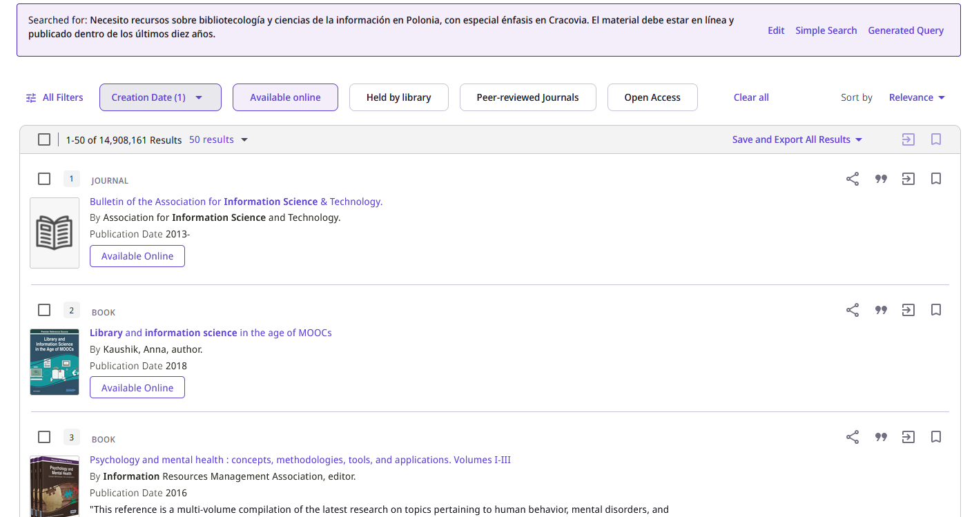
An example in the user's native language (not English) - 2
We get the results
Prefiltered by creation date and available online because this is what we asked for in the query

Slide 66
An example in the user's native language (not English) (example 3 of 5)

Slide 67
An example in the user's native language (not English) - 3
We will now use the Ask Anything Natural language Search in our native language (in this case Polish).
The “natural language search query” in English | The “natural language search query” in Polish
I need resources about library and information science in Poland, with a special emphasis on Krakow. The material should be online and published within the last ten years. | Potrzebuję materiałów na temat bibliotekoznawstwa i informacji naukowej w Polsce, ze szczególnym uwzględnieniem Krakowa. Materiały powinny być dostępne online i opublikowane w przeciągu ostatnich 10 lat.

Slide 68
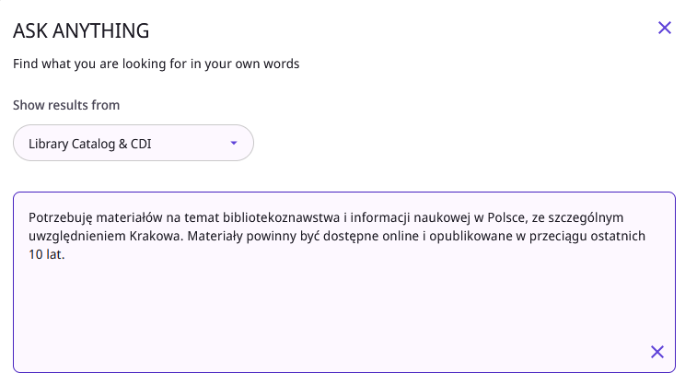
An example in the user's native language (not English) - 3
We use the Primo Ask Anything Natural language Search in our native language (in this case Polish).

Slide 69
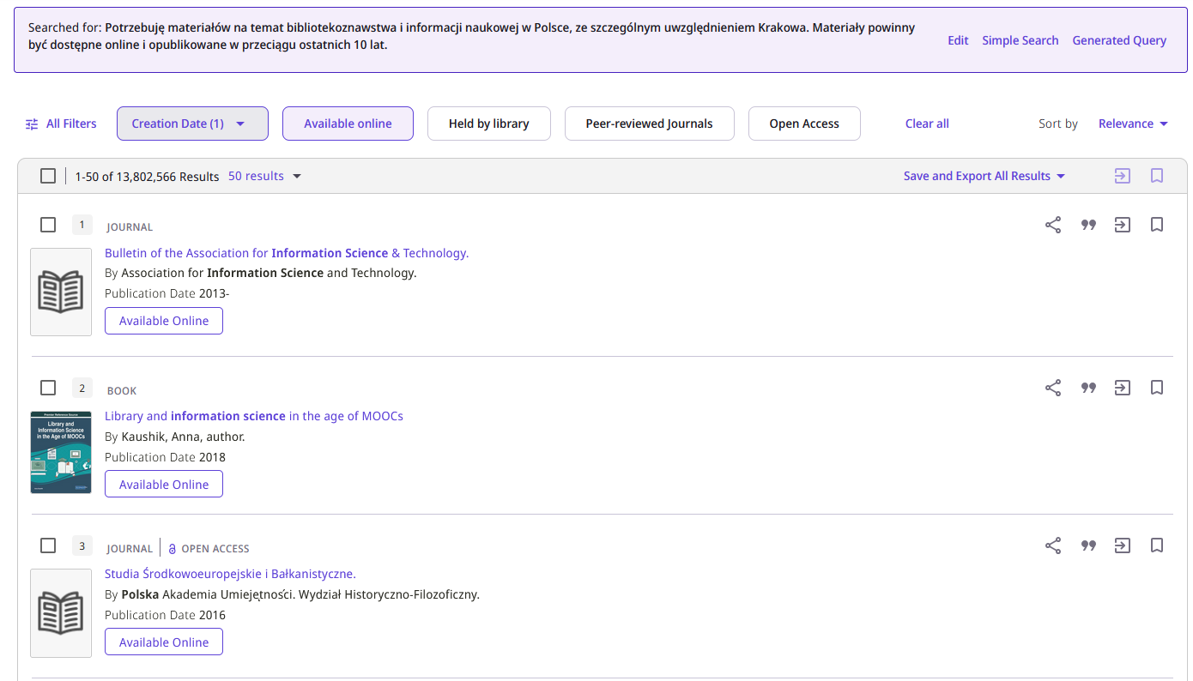
An example in the user's native language (not English) - 3
We get the results
Prefiltered by creation date and available online because this is what we asked for in the query
Prefiltered by creation date and available online because this is what we asked for in the query

Slide 70
An example in the user's native language (not English) (example 4 of 5)

Slide 71
An example in the user's native language (not English) - 4
We will now use the Ask Anything Natural language Search in our native language (in this case Hebrew).
The “natural language search query” in English | The “natural language search query” in Hebrew
I need resources about library and information science in Poland, with a special emphasis on Krakow. The material should be online and published within the last ten years. | אני זקוק למשאבים על ספרנות ומידענות בפולין, עם דגש מיוחד על קרקוב. ​​החומר צריך להיות מקוון ופורסם בעשר השנים האחרונות.

Slide 72
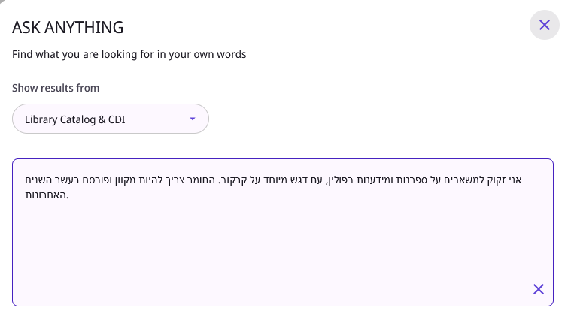
An example in the user's native language (not English) - 4
We use the Primo Ask Anything Natural language Search in our native language (in this case Hebrew).

Slide 73
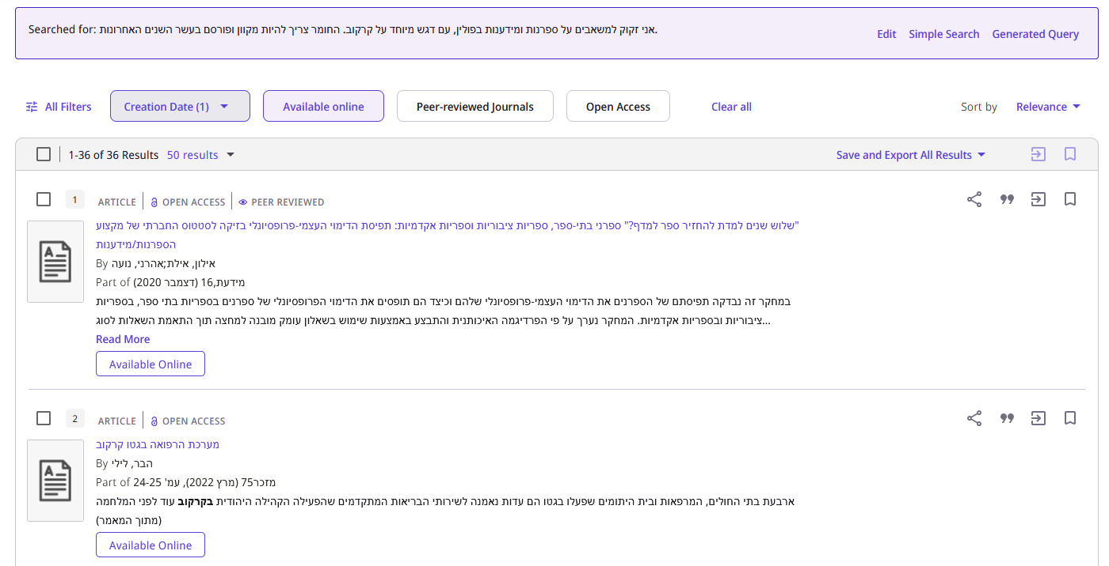
An example in the user's native language (not English) - 4
We get the results
Prefiltered by creation date and available online because this is what we asked for in the query

Slide 74
An example in the user's native language (not English) (example 5 of 5)

Slide 75
An example in the user's native language (not English) - 5
We will now use the Ask Anything Natural language Search in our native language (in this case Italian).
The “natural language search query” in English | The “natural language search query” in Italian
I need resources about library and information science in Poland, with a special emphasis on Krakow. The material should be online and published within the last ten years. | Ho bisogno di risorse relative alla biblioteconomia e alle scienze dell'informazione in Polonia, con particolare attenzione a Cracovia. Il materiale deve essere disponibile online e pubblicato negli ultimi dieci anni.

Slide 76
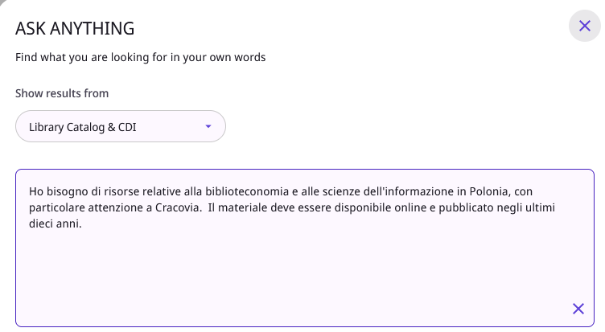
An example in the user's native language (not English) - 5
We use the Primo Ask Anything Natural language Search in our native language (in this case Italian).

Slide 77
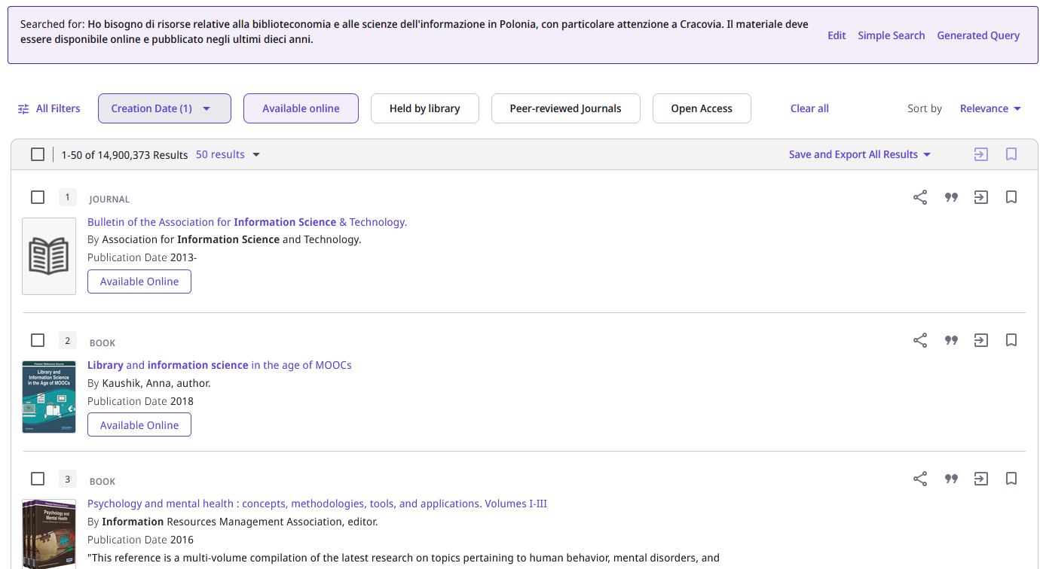
An example in the user's native language (not English) - 5
We get the results
Prefiltered by creation date and available online because this is what we asked for in the query

Slide 78
Thank You

